Slide 1



PROBLEM STATEMENT
Our team was tired of having to create a new Pottermore (the official Harry Potter website) account every time we wanted to take the Hogwarts House Quiz. We came up with the solution of our very own Hogwarts House Quiz, on a friendly interface, that can be taken as many times as the user wishes. It comes with added features of 2 side quizzes, 1 bonus item which is randomly assigned, access to uploaded reviews of all the 7 Harry Potter novels, and a mini game. Sorting of users into the houses and assigning different attributes they perfectly fit based on their characteristics.

Slide 2


List of modules
USER DEFINED
BUILT-IN MODULES
Login
House Quiz
Pie chart of results
Patronus Quiz
Wand Quiz
Sub-Menu for Quizzes
Randomly assigned pet
Book Reviews
List of all users + houses
Mini Game
Menu
Linking all modules
TKinter
PyGame
Matplotlib
NumPy
Random

Slide 3
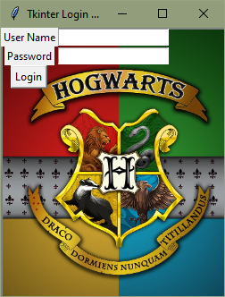
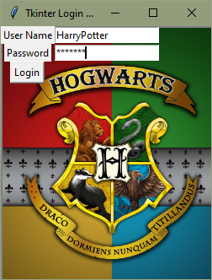
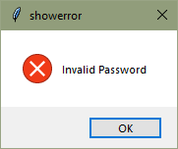

RESULTS & DISCUSSION

Slide 4
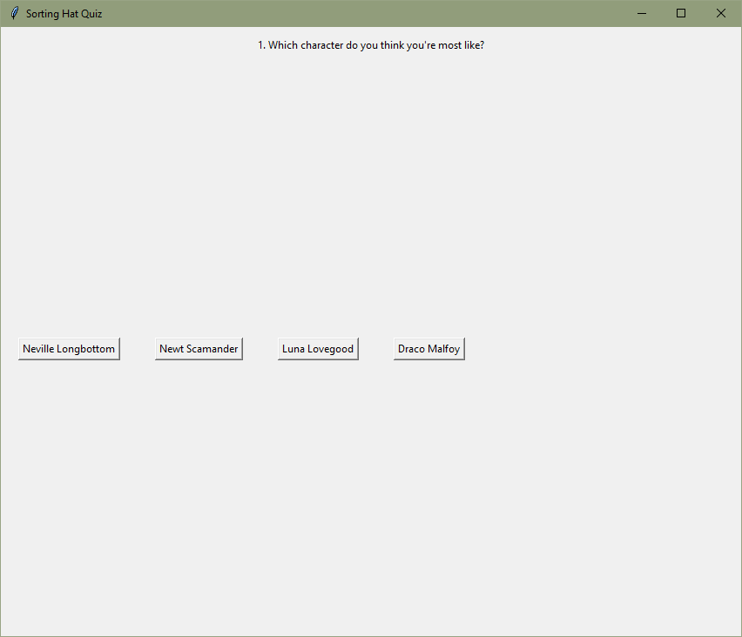
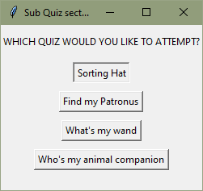
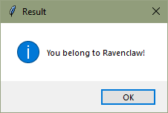
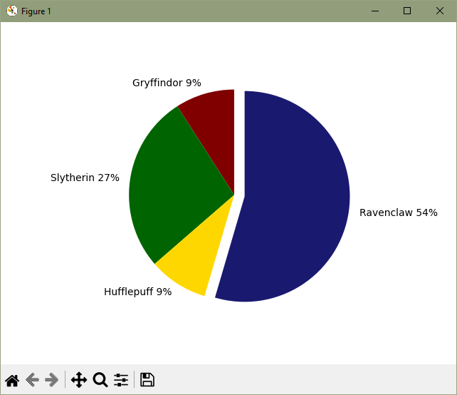
QUIZZES

Slide 5
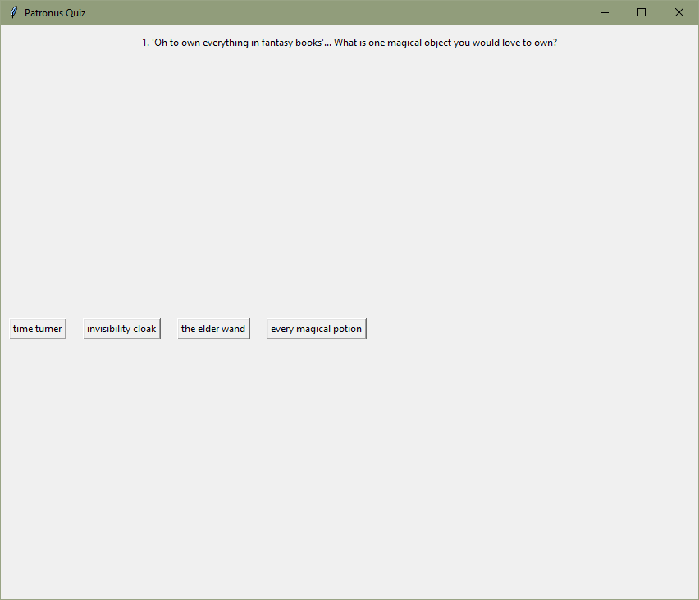
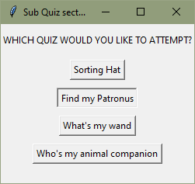
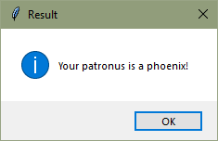
QUIZZES

Slide 6
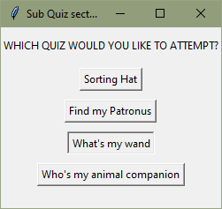
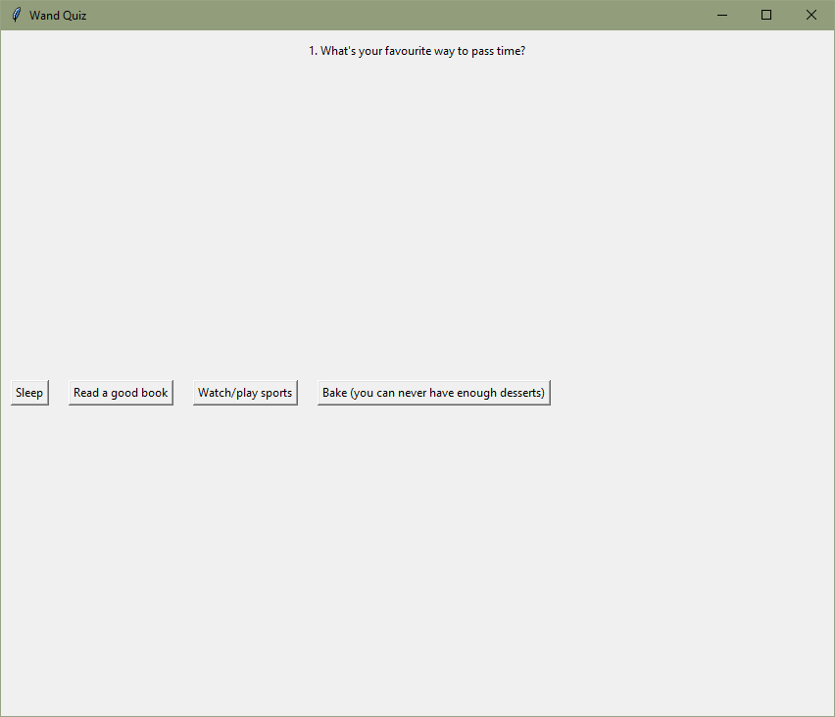
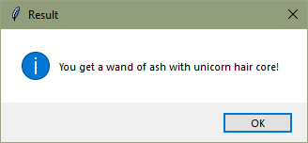
QUIZZES

Slide 7
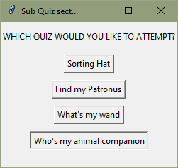
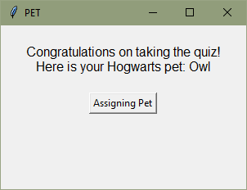
ASSIGNING YOUR PET

Slide 8
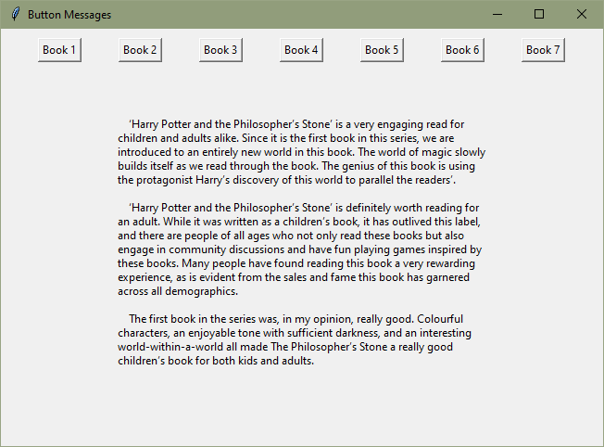
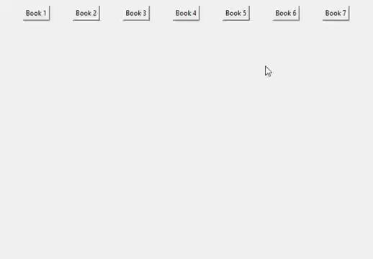
BOOK REVIEWS

Slide 9
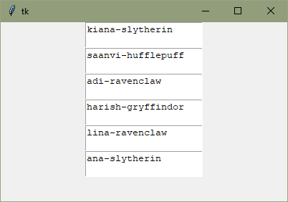
LIST OF USERS

Slide 10
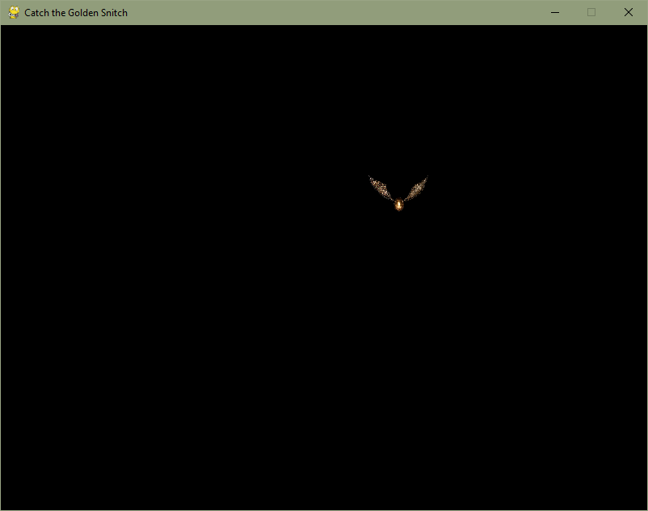
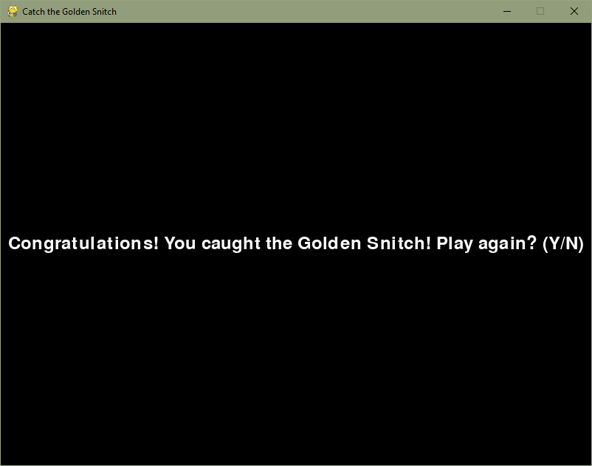

MINI GAME

